Slide 1

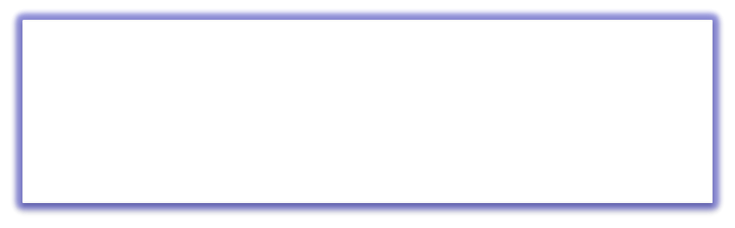

QUEUE
Free Powerpoint Templates
Free Powerpoint Templates _{Page 1}

Slide 2

Queue
Like stacks, queues are lists. With a queue, however, insertion is done at one end whereas deletion is done at the other end.
Queues implement the FIFO (first-in first-out) policy. E.g., a printer/job queue!
A new element is added at one end called rear end and the existing elements are
deleted from the other end called front end.
This mechanism is called First-In-First-Out (FIFO).
Page 2

Slide 3
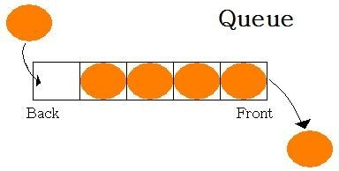
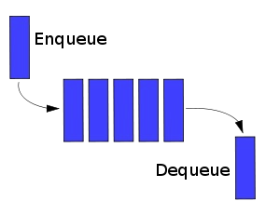
Fig: Models of a Queue

Slide 4
Conceptual View of a Queue
Adding an element
Front of queue
New element is added to the rear of the queue

Slide 5
Conceptual View of a Queue
Removing an element
New front element of queue
Element is removed from the front of the queue

Slide 6
Uses of Queues in Computing
For any kind of problem involving FIFO data
Printer queue (e.g. printer in MC 235)
Keyboard input buffer
GUI event queue (click on buttons, menu items)
To encode messages

Slide 7
Fig: Functions of a Queue
Queues implement the FIFO (first-in first-out) policy
An example is the printer/job queue!
enqueue(o)
dequeue()
isEmpty()
getFront()
createQueue()

Slide 8
Functions of a Queue
enqueue : add an element to the tail of a queue
dequeue : remove an element from the head of a queue
first : examine the element at the head of the queue (“peek”)
Other useful operations (e.g. is the queue empty)
It is not legal to access the elements in the middle of the queue!

Slide 9
Operations On A Queue
To insert an element in queue
Delete an element from queue

Slide 10
The Queue Operation
Placing an item in a queue is called “insertion or enqueue”, which is done at the end of the queue called “rear”.
Front
Rear

Slide 11
The Queue Operation
Removing an item from a queue is called “deletion or dequeue”, which is done at the other end of the queue called “front”.
Front
Rear

Slide 12
Algorithm QINSERT (ITEM)
If (rear = maxsize-1 )
print (“queue overflow”) and return
Else
rear = rear + 1 Queue [rear] = item

Slide 13
Algorithm QDELETE ()
If (front =rear)
print “queue empty” and return
Else
Front = front + 1 item = queue [front]; Return item

Slide 14
Queue Applications
Real life examples
Waiting in line
Waiting on hold for tech support
Applications related to Computer Science
Round robin scheduling
Job scheduling (FIFO Scheduling)
Key board buffer

Slide 15
3 states of the queue
Queue is empty
FRONT=REAR
Queue is full
REAR=N
Queue contains element >=1
FRONT<REAR
NO. OF ELEMENT=REAR-FRONT+1

